Slide 1
Business Intelligence and Data Warehousing (ANL408)
- By Sabarish Nair

Slide 2
About me...
9 years of work experience
Bachelors in Information Technology
Masters in Business Analytics
Worked as a software developer, senior analyst and product manager

Slide 3
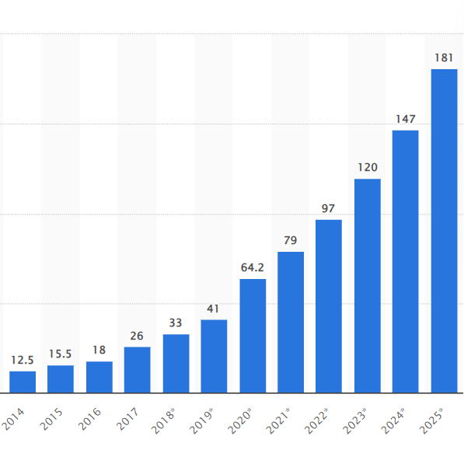
Data and Data Explosion
Data getting generated at a rapid pace.
Internet Usage, Digital Transformation, IoT Devices, Big Data, Social Media, etc, contributing to the data explosion.
SUCCESS = DATA-DRIVEN INSIGHTS!!
Image Source: Statista

Slide 4
Types of Data
Structured Data: Highly Organized and formatted in a predefined manner. (E.g., Relational database, spreadsheet and CSV Files)
Unstructured Data: Lacks a predefined model or structure. (E.g., Images, Video and Audio)
Semi-Structured Data: Has some organizational properties making it easier to analyze. (E.g., JSON, XML)

Slide 5
Database
"An organized collection of data designed to efficiently manage, store, retrieve, and update large amounts of data."
Structured Data: Relational Databases (MySQL, PostgreSQL, etc.)
Unstructured Data: Object Stores (Amazon S3, Google Cloud Storage, etc.)
Semi-Structured Data: NoSQL Databases (MongoDB, Cassandra, etc.)

Slide 6
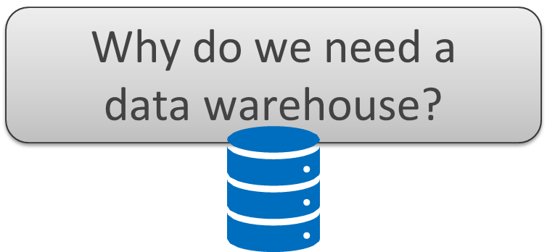

Slide 7
Problem Statements
"Yes, we have a lot of data but we don't use it"
"Our data is very complicated and difficult to analyze"
"It's spread all over the different systems and difficult to access"
"I just want to see what is relevant!"
"We need to access data quick and easily"
"We want to make fact-based decisions!"

Slide 8
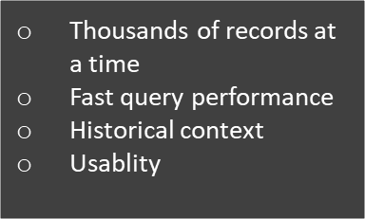

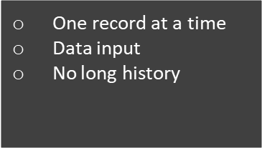

Two Purposes!
Analytical Decision Making
Operational Data Keeping

Slide 9
Why do we need data warehouse?
Consolidation of information sources.
Improved query performance
Separate research and decision support systems from operational systems.
Foundation for data mining, data visualization, advanced reporting, and OLAP tools.

Slide 10
What is data warehouse?
Database used and optimized for analytical purposes.
Subject-Oriented, Integrated, Time-Variant Non-volatile collection of data in support of decision making

Slide 11
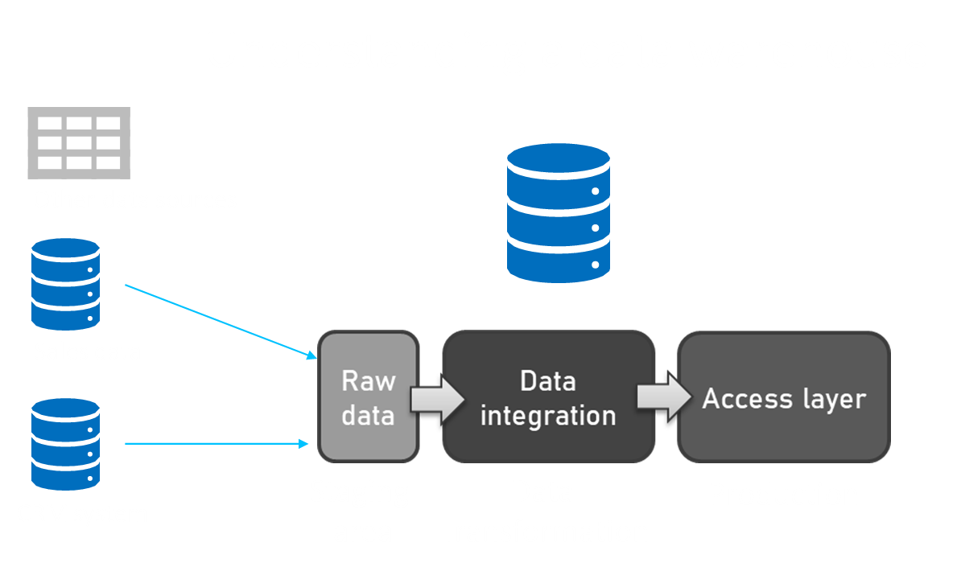
Data warehouse landscape
Sales
CRM
Other systems
Staging
Data Transformation

Slide 12
Components of Data warehouse
ETL Solutions
Reporting
Data Mining Capabilities
Other in-house applications

Slide 13
Characteristics of Data Warehouse
Centralized and consistent location of data
Fast query performance
User friendly
Consistent and repeated data loading (ETL)
Reporting and data visualization (built on top)

Slide 14
Data warehouse software
Amazon Redshift
Azure Synapse Analytics and Azure SQL database
Google Big Query
Snowflake data warehouse
Teradata
And many more....

Slide 15
Database vs Data Warehouse
Purpose | Data warehouse | Database
Purpose | Analysis | Reporting
Database | OLAP | OLTP
Type of collection | Subject-oriented | Application-oriented
Query | Complex analytical queries | Simple transaction queries

Slide 16
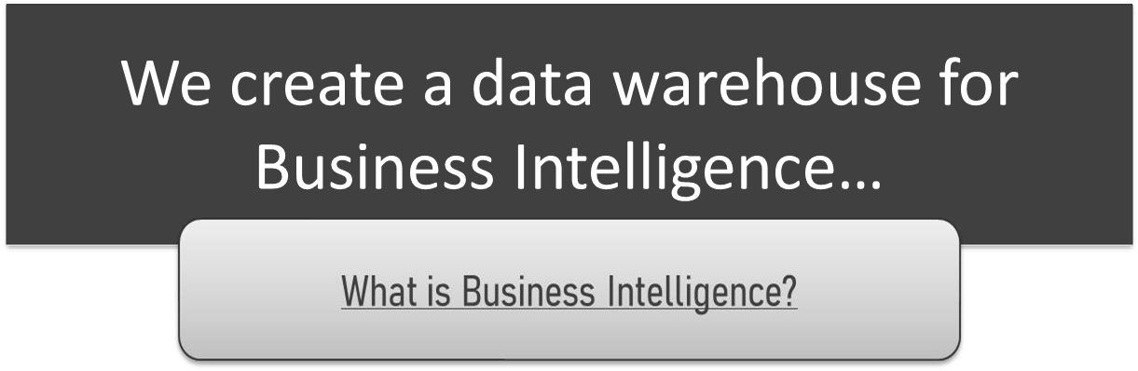

Slide 17
Business Intelligence (BI)
The process of drawing critical insights from data to inform decisions.
Technology that allows gathering, storing, accessing, and analyzing data to help users make better decisions.
Notes:
What business problem we are trying to solve?
What data is relevant to calculate the product’s commercial viability?
Where can the data be sourced from?

Slide 18
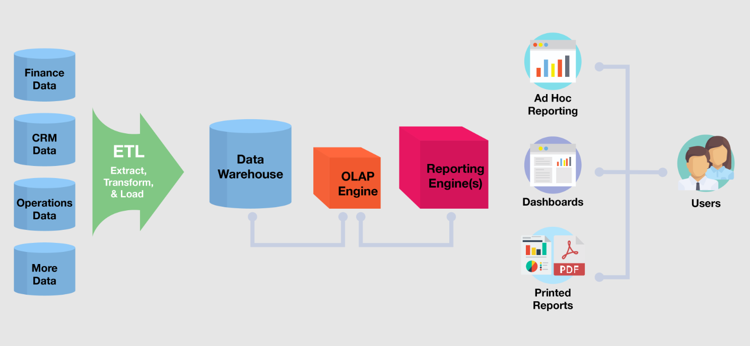
BI Example
Notes:
How many products were sold due to TV ads last month?
If inventory levels drop by 10%, what impact will it have on customers?
Which customer demographic is best suited for Product A?

Slide 19
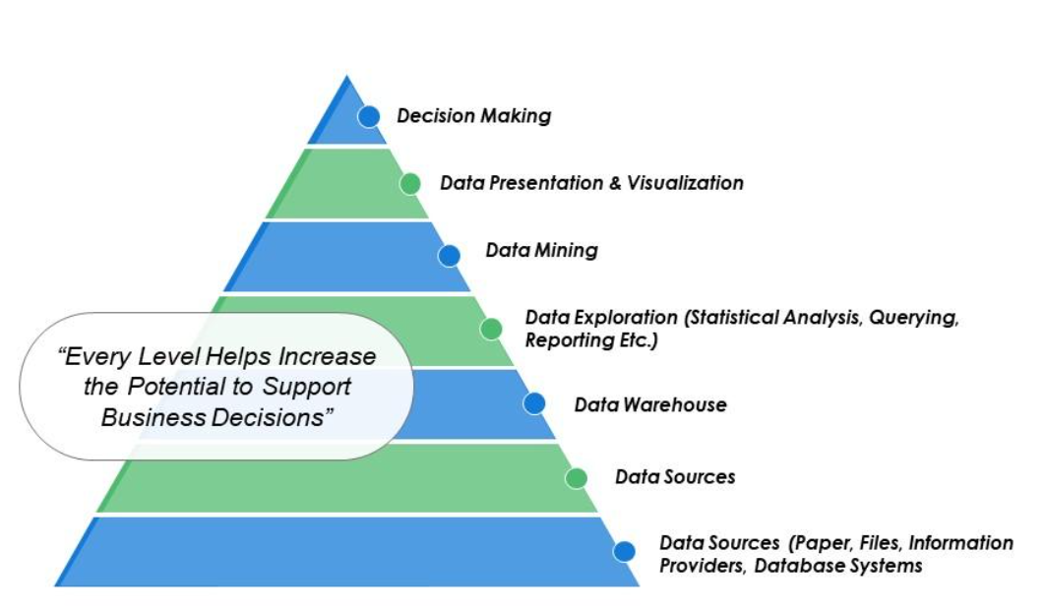
BI Process

Slide 20
BI Components
Data Warehouse: A decision support database that is maintained separately from the organization’s operational database.
Online Transactional Processing (OLTP) – A class of information systems that facilitate and manage transaction-oriented applications (ATMs, online booking applications, etc.)
Online Analytical Processing (OLAP) – Approach to answer multi-dimensional queries (drill down, slicing and dicing, marketing analysis, supply and demand forecasting)
Notes:
Data warehouse: Brings data from multiple data sources for decision support queries.

Slide 21

BI Uses
Business Operations Reporting
Forecasting
Dashboard
Multidimensional analysis
Finding correlation among different factors

Slide 22
BI Tool
Tableau
Power BI
QlikView
Google Data Studio
And many more.....

Slide 23

Practical Example: Doctor Strange in the Multiverse of Madness
How can you help Marvel Studios identify trends and insights from social media (X, formerly Twitter)?
Suggest recommendations to Marvel Studio on how to utilize the findings.
Find distinct trends, analyses, and patterns in your data.
Analysis to be performed on at least 800 tweets collected over a time period.

Slide 24

Steps to be followed
Extract data from X using hashtags like #Marvel, #DoctorStrange2, etc. (Using R)
1
Cleanse the data to remove noise, junk data, etc. (Using R and SQL)
2
Perform sentiment analysis (Using R)
3
Find various KPIs by plotting charts (Tableau)
4
Create a dashboard and summarize the findings (Tableau)

Slide 25
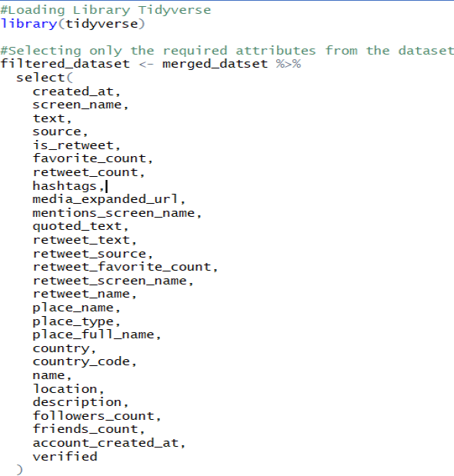
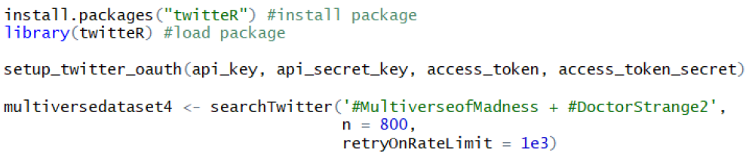
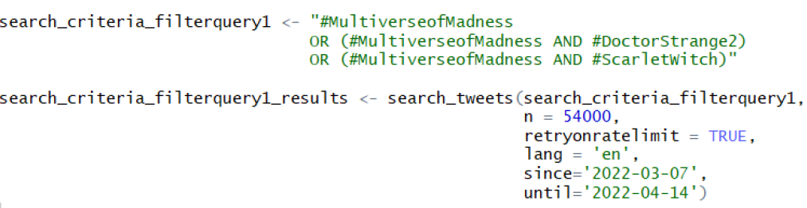
Code Snippets

Slide 26
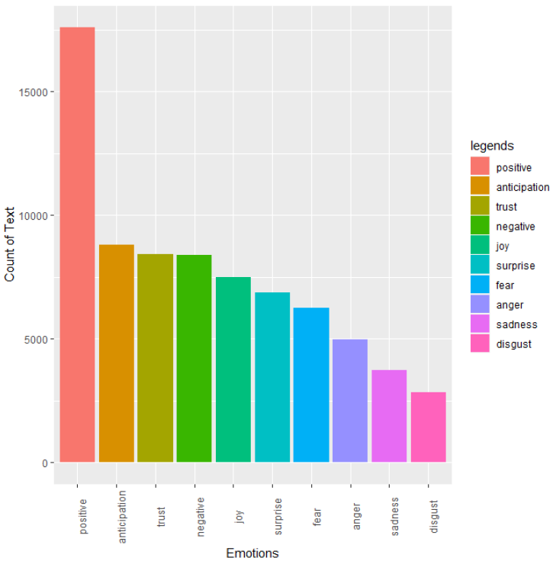
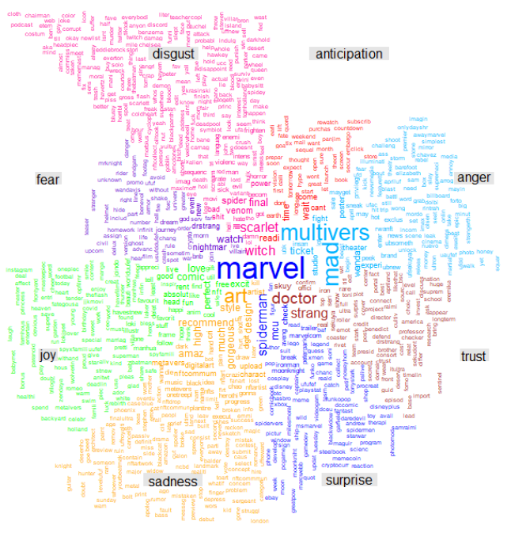
Sentiment Analysis

Slide 27
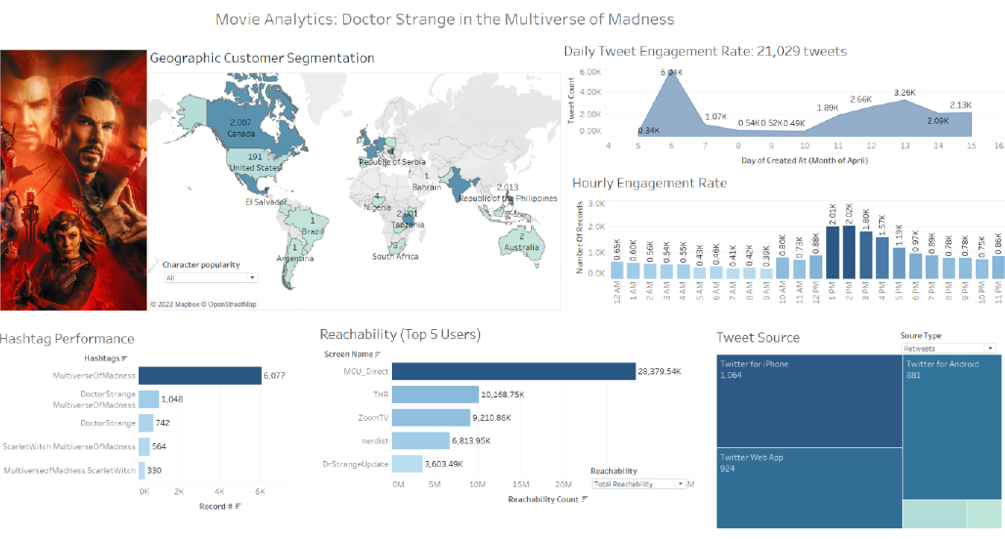
Dashboard

Slide 28
Recommendations to Marvel Studios
Sr. No. | KPI | Recommendations
1 | Geographic customer segmentation and character popularity | 1. Target countries with Marvel comic fans like the US, India, UK, etc. for movie promotion, 2. Revise marketing strategies in other countries, 3. Send the lead actors to regions with a huge fan Bases
2 | Customer Engagement | 1. Improve daily engagement rate threshold 2. Create social media buzz by lead actors 3. Utilize timeslot between 1 PM and 3 PM for promotional activities
3 | Hashtag performance | 1. Utilize top 10 hashtags for future posts 2. Analyze user sentiments from hashtags
4 | Reachability | 1. Use influencer marketing 2. Hire Top Influencers to promote films since it is cost-effective
5 | Tweet Source | 1. Devise marketing strategies for iPhone Users 2. Develop custom content and advertisements tailored to iPhone users based on their Demographics

Slide 29


